Slide 1
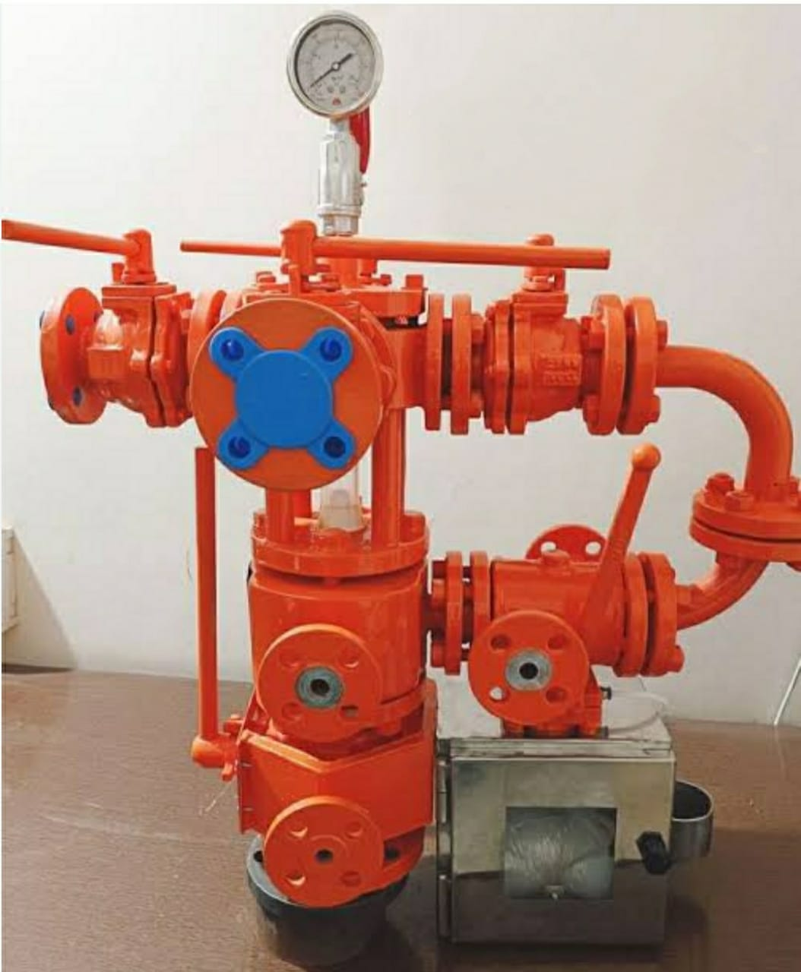
REACTOR TOP SAMPLING SYSTEM
Since 1987
SIZE :AS PER REACTOR NOZZEL SIZE
150#/300#/PN10/PN16
MOC:CS/SS304/SS316/SS316L/SS317L –WITH PFA/FEP LINING OR WITHOUT

