Slide 1
PROJECTS ASSEMBLED
TURNKEY
Dhanush
Kavach
BMP
T-90
Lins

Slide 2
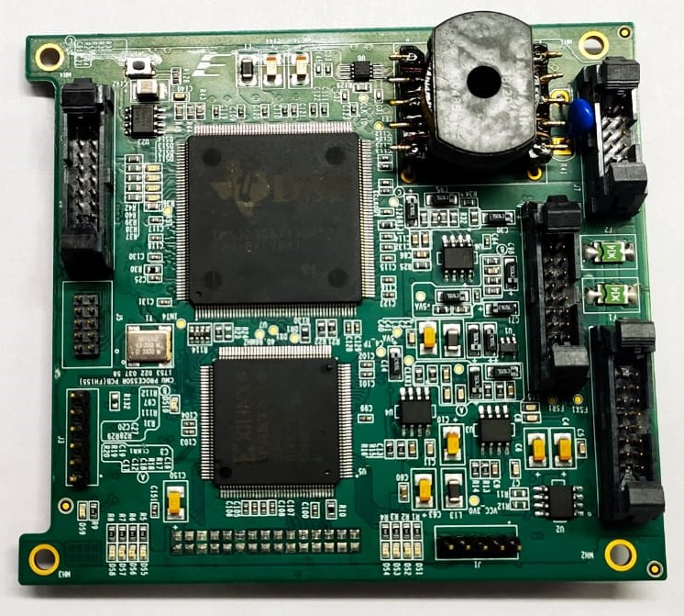
DHANUSH
CMU PROCESSOR CARD

Slide 3
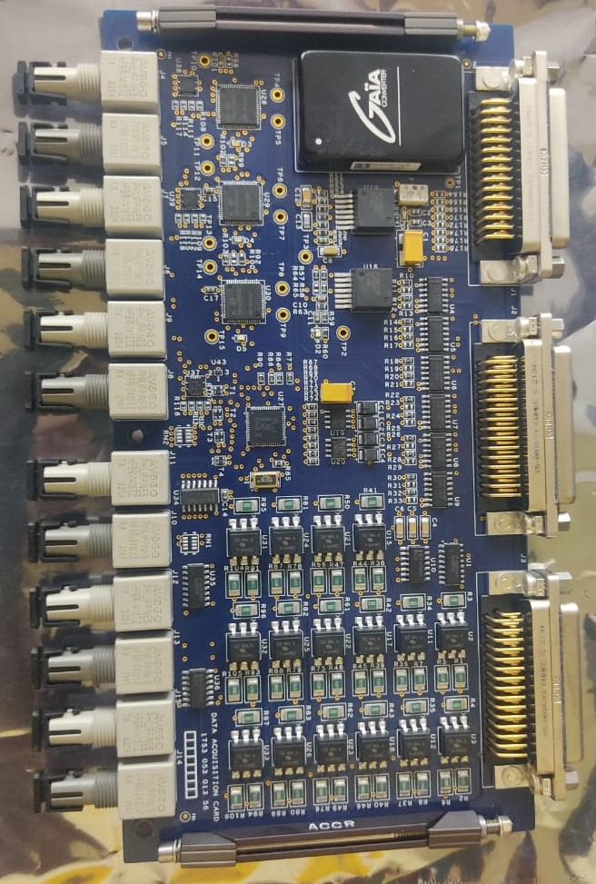
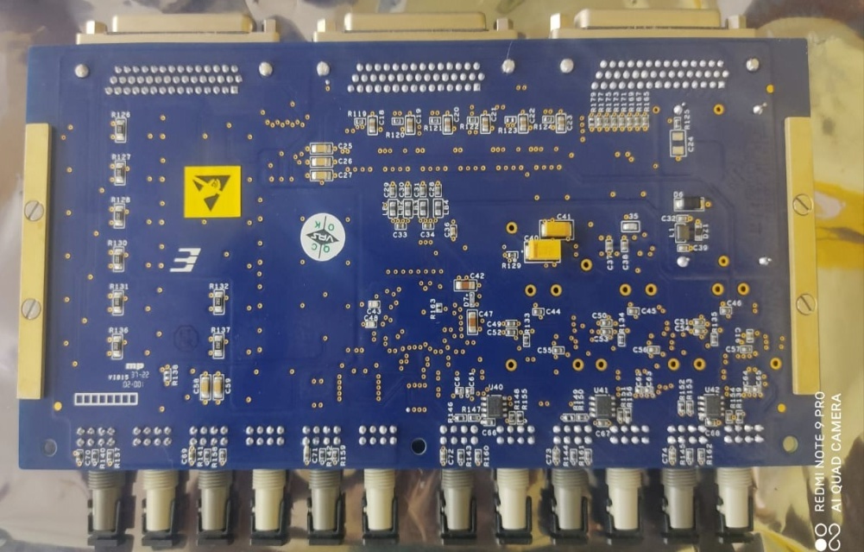
Kavach
Data Acquisition Card

Slide 4
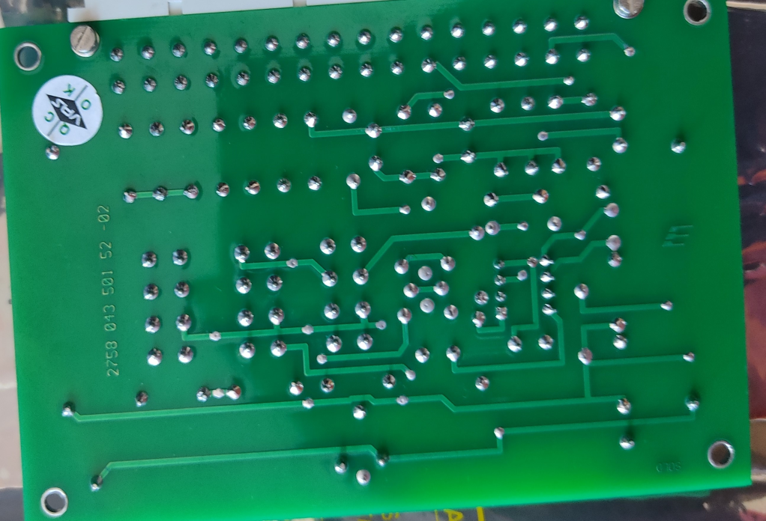
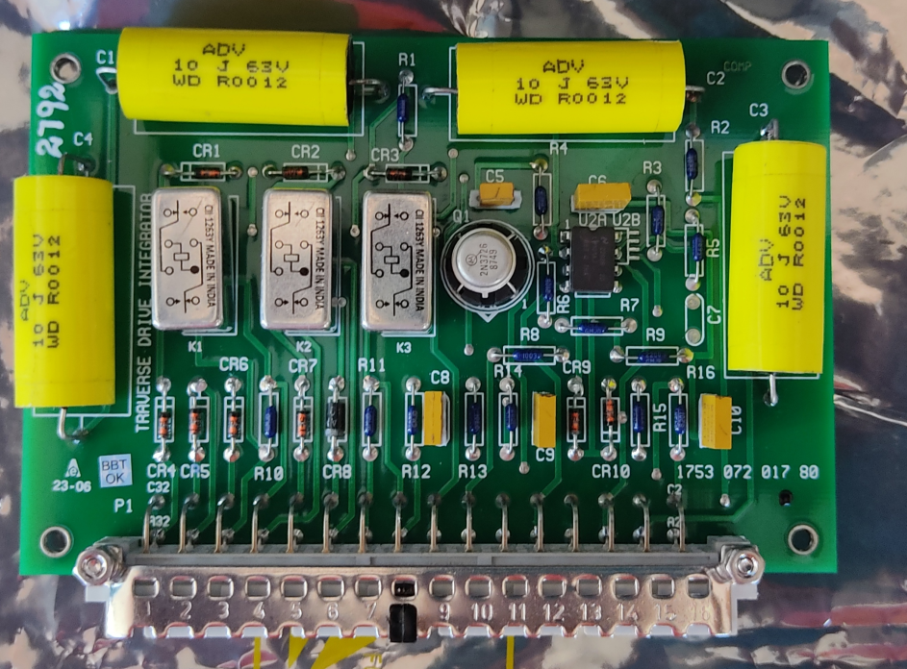
BMP - II
Traverse Drive Integrator

Slide 5
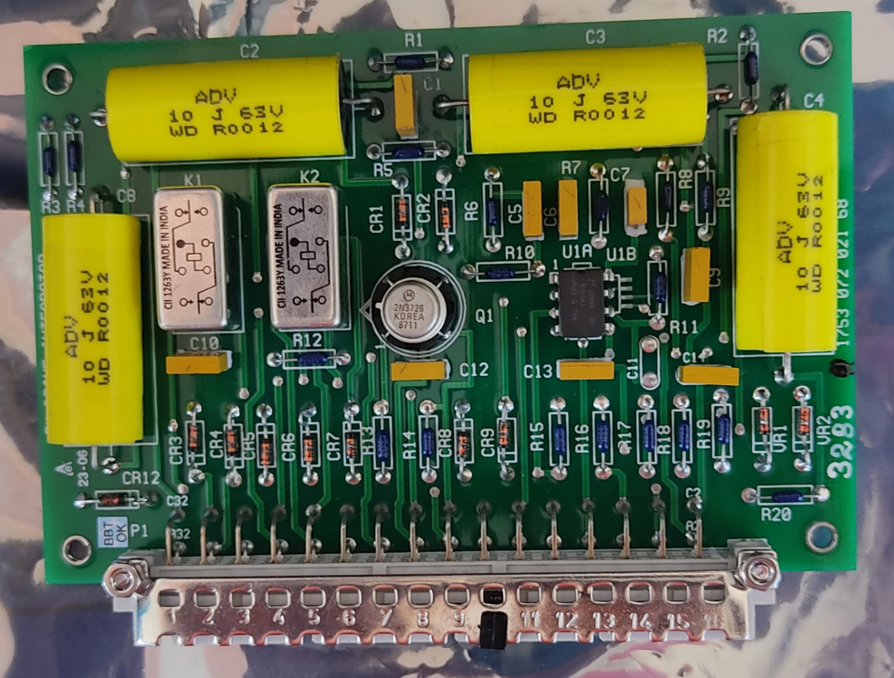
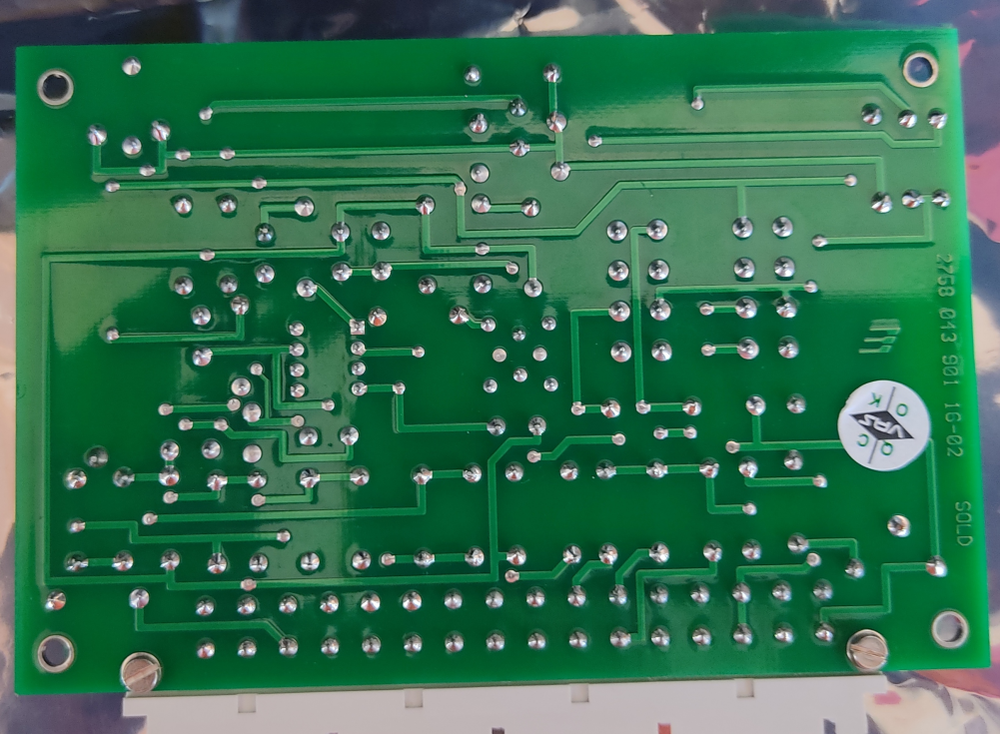
EL.Drive Integrator

Slide 6
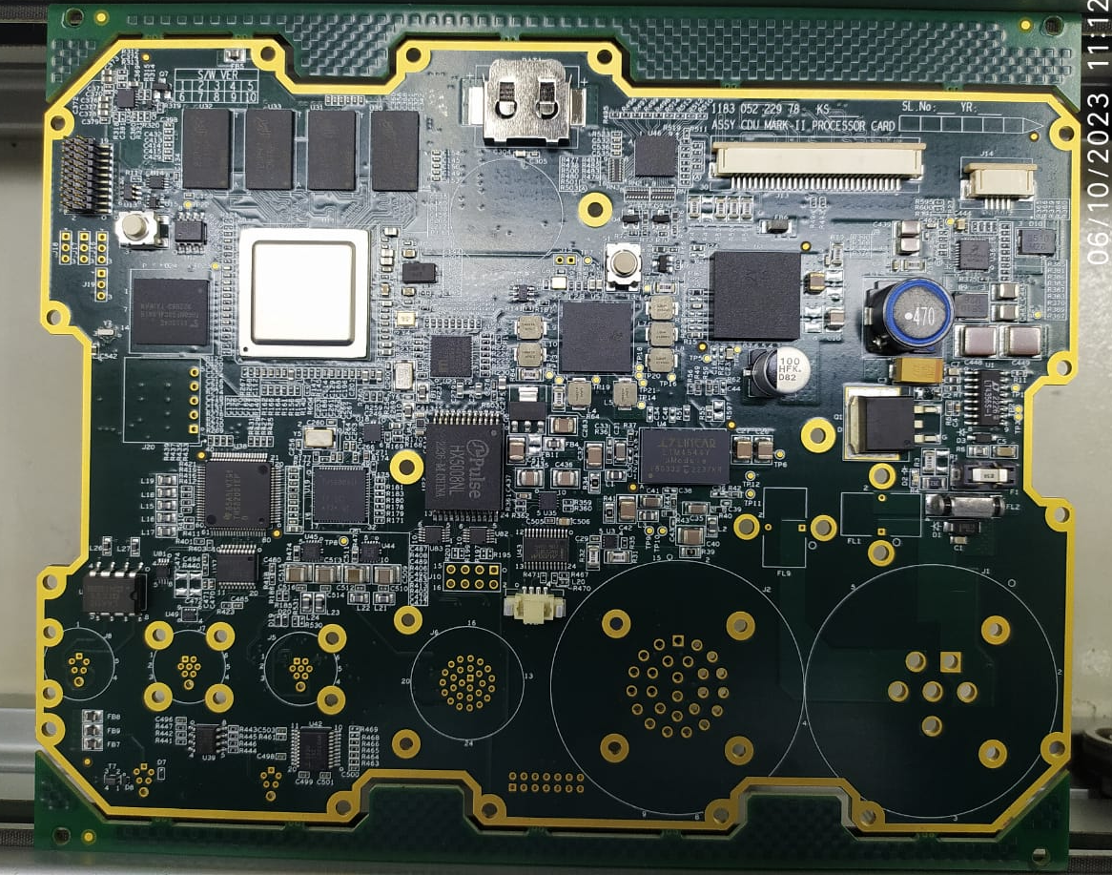
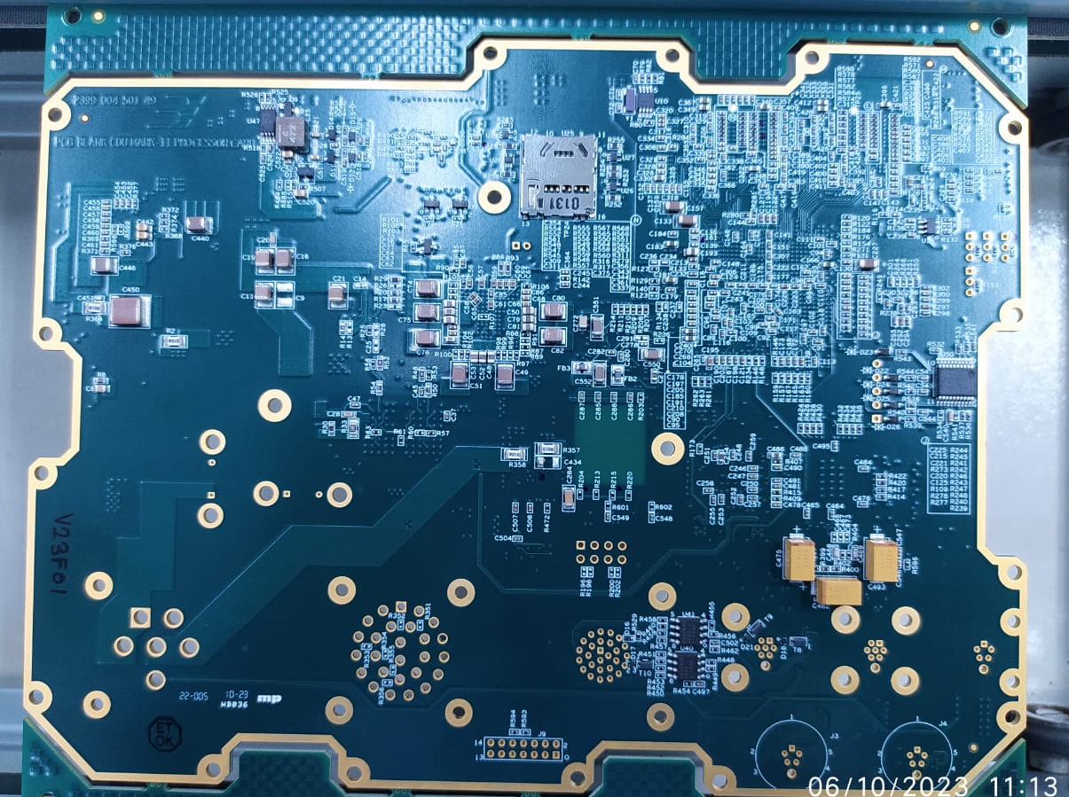
Lins
CDU MKII PCBA

