Slide 1
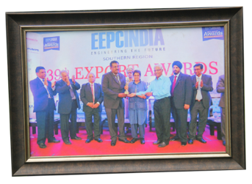
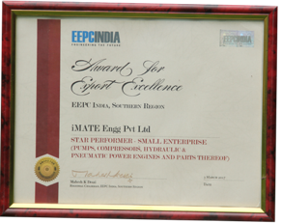
AWARDS & CERTIFICATIONS
Achieved STAR PERFORMER Export Award from EEPC –Southern Regional Exports for the period 2014-15
Certificate
Trophy
Award received from Mrs. Kiran Pedi,
Honourable Lieutenant Governor, Puducherry,
Tamilnadu, and EEPC Officials

Slide 2
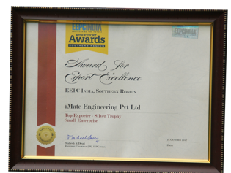
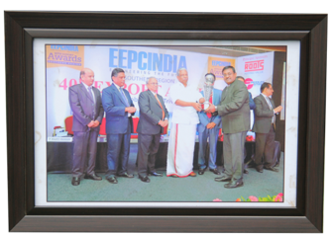
AWARDS & CERTIFICATIONS
Achieved TOP EXPORTER –Silver Trophy Award from EEPC –Southern Regional Exports for the period 2016-17
Certificate
Trophy
Received from Honorable Industrial Minister,
Kerala and EEPC Officials

Slide 3
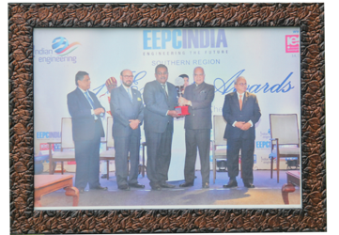
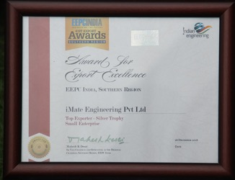
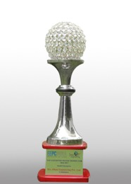
AWARDS & CERTIFICATIONS
Achieved TOP EXPORTER –Silver Trophy Award from EEPC –Southern Regional Exports for the period 2016-17
Certificate
Trophy
Received from Mr.Banwarilal Purohit,
Honorable Governor, Tamilnadu and EEPC Officials

Slide 4
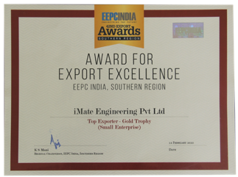
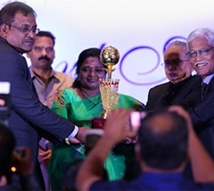
AWARDS & CERTIFICATIONS
Achieved South India Export Performance - Top Exporter - Gold Trophy for the year 2017-2018
Certificate
Trophy
Received from Dr. Tamilisai Soundararajan,
Hon’ble Governor of Telangana and EEPC Officials on Feb 12, 2020

Slide 5
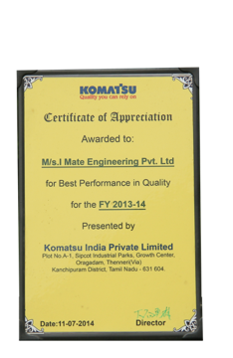
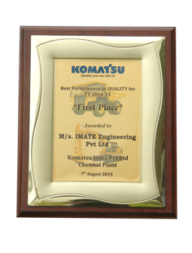
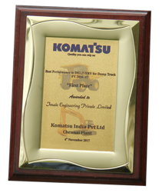
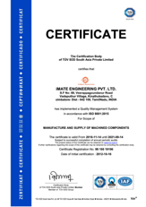
AWARDS & CERTIFICATIONS
Achieved best supplier award
from KOMATSU during the
period of 2013 - 14
Achieved best supplier award
from KOMATSU during the
period of 2012 - 13
Achieved best supplier award from
KOMATSU during the period of 2014-15
Achieved best supplier award
from KOMATSU during the period of 2016-17
ISO 9001:2015Certificate

